Slide 1
Software Requirements Engineering
By
Abid Ali
BS Software Engineering
5th
Lecture #1

Slide 2
PART I
SOFTWARE REQUIREMENTS: WHAT, WHY, AND WHO

Slide 3
Chapter 1
The Essential Software Requirement

Slide 4
Agenda
Software requirements defined
Some interpretations of ”requirement”
Levels and types of requirements
Working with the three levels
Product vs. project requirements
Requirements development and management
Requirements development
Requirements management
Every project has requirements
When bad requirements happen to good people
Insufficient user involvement
Inaccurate planning
Creeping user requirements
Ambiguous requirements
Gold plating
Overlooked stakeholders
Benefits from a high-quality requirements process

Slide 5
Introduction
Requirements form the basis for all software products
Requirements engineering is the process, which enables us to systematically determine the requirements for a software product

Slide 6
Software Requirements Defined
When a group of people begin discussing requirements, they often start with a terminology problem.
Different observers might describe a single statement as being a user requirement, software requirement, business requirement, functional requirement, system requirement, product requirement, project requirement, user story, feature, or constraint.
The names they use for various requirements deliverables also vary. A customer’s definition of requirements might sound like a high-level product concept to the developer.
The developer’s notion of requirements might sound like a detailed user interface design to the user.
This diversity of understanding leads to confusion and frustration.

Slide 7
Some interpretations of ”requirement”
Requirements are a specification of what should be implemented.
They are descriptions of how the system should behave, or of a system property or attribute.
They may be a constraint on the development process of the system.

Slide 8
Software Requirements - 1
A complete description of what the software system will do without describing how it will do , is represented by the software requirements

Slide 9
Software Requirements - 2
Software requirements are complete specification of the desired external behavior of the software system to be built.
Behavior may be in two forms i.e
Reaction of system by different inputs
Reaction in different situations
They also represent External behavior of the system

Slide 10
Software Requirements - 3
Software requirements may be:
Abstract statements of services and/or constraints
Detailed mathematical functions

Slide 11
Software Requirements - 4
Software requirements may be:
Part of the bid of contract
The contract itself
Part of the technical document, which describes a product

Slide 12
IEEE Definition
A condition or capability that must be met or possessed by a software system...to satisfy a contract, standard, specification, or other formally imposed document
IEEE Std 729

Slide 13
Sources of Requirements
Stakeholders
People affected in some way by the system i.e
They interested in existing system or proposed system
Or they develop software
Documents e.g
Text liabilities
Text regulation
Existing system
Domain/business area

Slide 14
Examples of Requirements - 1
The system shall maintain records of all payments made to employees on accounts of salaries, bonuses, travel/daily allowances, medical allowances, etc.

Slide 15
Examples of Requirements - 2
The system shall interface with the central computer to send daily sales and inventory data from every retail store

Slide 16
Examples of Requirements - 3
The system shall maintain records of all library materials including books, serials, newspapers and magazines, video and audio tapes, reports, collections of transparencies, CD-ROMs, DVDs, etc.

Slide 17
Examples of Requirements - 4
The system shall allow users to search for an item by title, author, or by International Standard Book Number.
The system’s user interface shall be implemented using a web browser

Slide 18
Examples of Requirements - 5
The system shall support at least twenty transactions per second
The system facilities which are available to public users shall be demonstrable in ten minutes or less

Slide 19
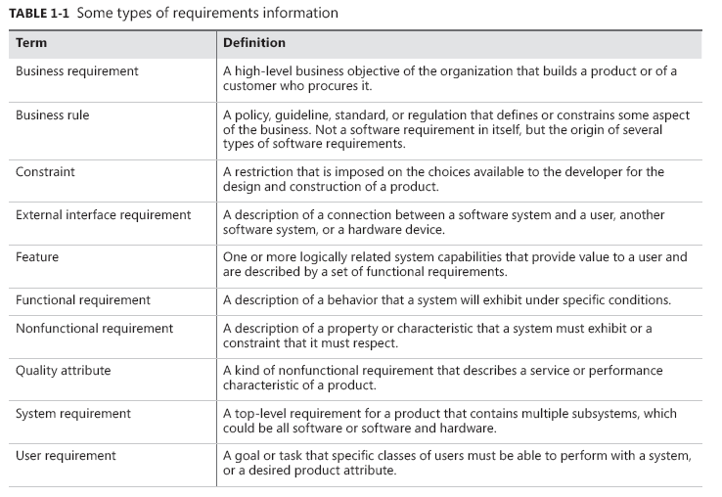
Levels And Types Of Requirements

Slide 20
Importance of Software Requirements
The hardest single part of building a software system is deciding what to build...No other part of the work so cripples the resulting system if done wrong. No other part is difficult to rectify later
Fred Brooks

Slide 21
Cont..
Software requirements include three distinct levels:
business requirements,
user requirements, and
functional requirements.
The model in Figure 1-1 illustrates a way to think about these diverse types of requirements.
The ovals in Figure 1-1 represent types of requirements information, and the rectangles indicate documents in which to store that information.

Slide 22
Cont..
The solid arrows indicate that a certain type of information typically is stored in the indicated document.
(Business rules and system requirements are stored separately from software requirements, such as in a business rules catalog or a system requirements specification, respectively.)
The dotted arrows indicate that one type of information is the origin of or influences another type of requirement.

Slide 23
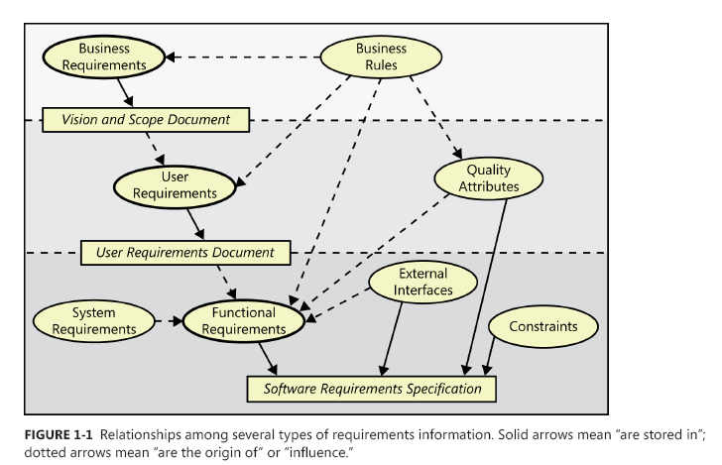
Cont..

Slide 24
Working with the three levels
Figure 1-3 illustrates how various stakeholders might participate in eliciting the three levels of requirements.
Different organizations use a variety of names for the roles involved in these activities; think about who performs these activities in your organization.
The role names often differ depending on whether the developing organization is an internal corporate entity or a company building software for commercial use.

Slide 25
FIGURE 1-3 An example of how different stakeholders participate in requirements development

Slide 26
Product Vs. Project Requirements
Product requirements:
Requirements that describe properties of a software system to be built.
Projects requirements:
Requirements that represent other expectations and deliverables that are not a part of the software the team implements, but that are necessary to the successful completion of the project as a whole.

Slide 27
Cont..
Project requirements include:
Physical resources the development team needs, such as workstations, special hardware devices, testing labs, testing tools and equipment, team rooms, and videoconferencing equipment.
Staff training needs
User documentation, including training materials, tutorials, reference manuals, and release notes.
Support documentation, such as help desk resources and field maintenance and service information for hardware devices.

Slide 28
Cont..
Infrastructure changes needed in the operating environment.
Requirements and procedures for releasing the product, installing it in the operating environment, configuring it, and testing the installation
Requirements and procedures for transitioning from an old system to a new one, such as data migration and conversion requirements, security setup, production cutover, and training to close skills gaps; these are sometimes called transition requirements (IIBA 2009).

Slide 29
Cont..
Product certification and compliance requirements.
Revised policies, processes, organizational structures, and similar documents.
Sourcing, acquisition, and licensing of third-party software and hardware components.
Beta testing, manufacturing, packaging, marketing, and distribution requirements.
Customer service-level agreements.
Requirements for obtaining legal protection (patents, trademarks, or copyrights) for intellectual property related to the software.

Slide 30
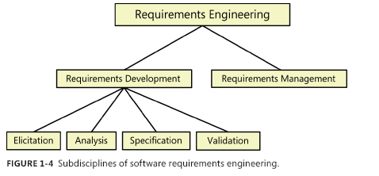
Requirements development and management
Requirements engineering:
Requirements development
Requirements management

Slide 31
Requirements development
As Figure 1-4 shows, we subdivide requirements development into elicitation, analysis, specification, and validation (Abran et al. 2004). These sub disciplines encompass all the activities involved with exploring, evaluating, documenting, and confirming the requirements for a product.
Following are the essential actions in each sub discipline:

Slide 32
Elicitation
Elicitation encompasses all of the activities involved with discovering requirements, such as interviews, workshops, document analysis, prototyping, and others. The key actions are:
Identifying the product’s expected user classes and other stakeholders.
Understanding user tasks and goals and the business objectives with which those tasks align.
Learning about the environment in which the new product will be used.
Working with individuals who represent each user class to understand their functionality needs and their quality expectations

Slide 33
Analysis
Analyzing requirements involves reaching a richer and more precise understanding of each requirement and representing sets of requirements in multiple ways. Following are the principal activities:
Analyzing the information received from users to distinguish their task goals from functional requirements, quality expectations, business rules, suggested solutions, and other information
Decomposing high-level requirements into an appropriate level of detail

Slide 34
Cont..
Deriving functional requirements from other requirements information
Understanding the relative importance of quality attributes
Allocating requirements to software components defined in the system architecture
Negotiating implementation priorities
Identifying gaps in requirements or unnecessary requirements as they relate to the defined scope

Slide 35
Specification
Requirements specification involves representing and storing the collected requirements knowledge in a persistent and well-organized fashion. The principal activity is:
Translating the collected user needs into written requirements and diagrams suitable for comprehension, review, and use by their intended audiences.

Slide 36
Validation
Requirements validation confirms that you have the correct set of requirements information that will enable developers to build a solution that satisfies the business objectives. The central activities are:
Reviewing the documented requirements to correct any problems before the development group accepts them.
Developing acceptance tests and criteria to confirm that a product based on the requirements would meet customer needs and achieve the business objectives

Slide 37


Slide 38
Requirements Management
Requirements management activities include the following:
Defining the requirements baseline, a snapshot in time that represents an agreed-upon, reviewed, and approved set of functional and nonfunctional requirements, often for a specific product release or development iteration
Evaluating the impact of proposed requirements changes and incorporating approved changes into the project in a controlled way

Slide 39
Cont..
Keeping project plans current with the requirements as they evolve
Negotiating new commitments based on the estimated impact of requirements changes
Defining the relationships and dependencies that exist between requirements
Tracing individual requirements to their corresponding designs, source code, and tests
Tracking requirements status and change activity throughout the project

Slide 40
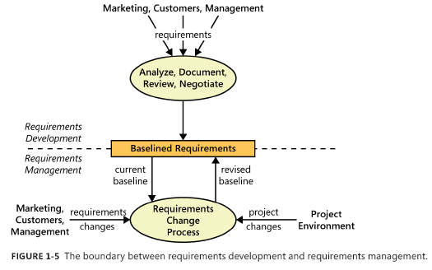
Cont..
Figure 1-5 provides another view of the boundary between requirements development and requirements management.

Slide 41
The end
Thank you

